Slide 1
Safety Sign Postings in the Chemistry Dep’t
October 3, 2018
Paul Bower

Slide 2
Safety Sign Postings
Room Rules
Hazard Assessments
24 Hour Emergency Contact
Emergency Assembly Areas (EAA)
Non-Exit door

Slide 3
Room Rules
The “Room Rules” poster is required, and focuses on protective wear, solitary work with hazardous materials or operations, and eating/drinking in the work area. These two issues constitute a fraction of general safety concerns, but are regarded as a primary focus in buildings where laboratory work with chemical, biological, and radiological hazards is ubiquitous.
At least one Room Rules poster is to be placed visibly in every appropriate room -- labs, shops, e.g., and any location where likely activities would indicate that such requirements are warranted.
It serves as a “What do I need to be wearing and be aware of before entering this room” notice.

Slide 4
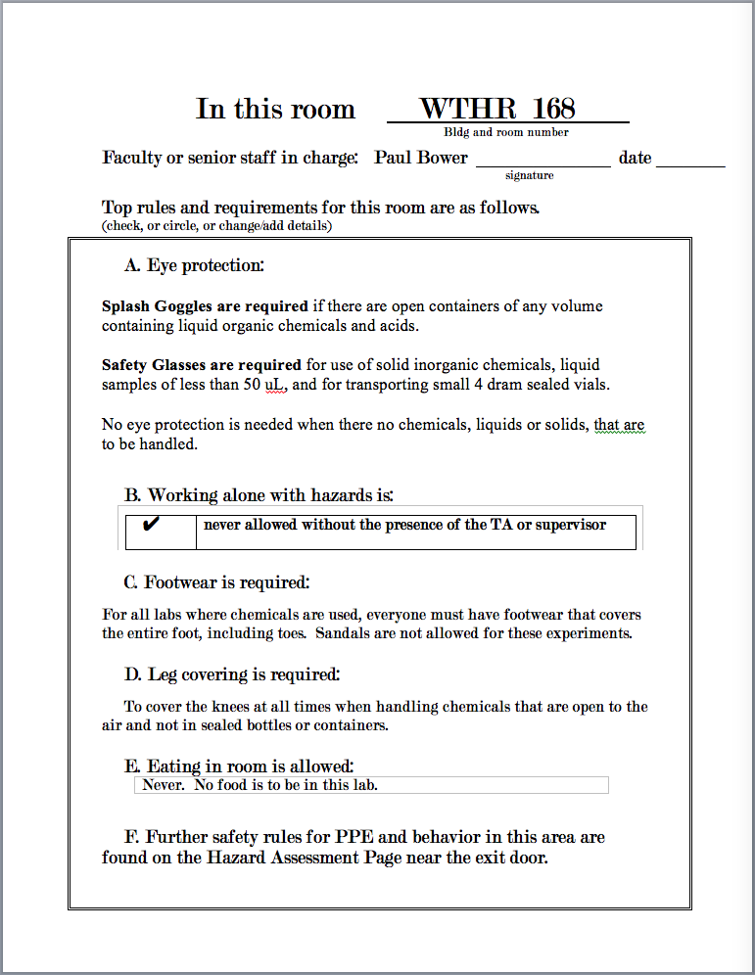
Room Rules
Example:

Slide 5
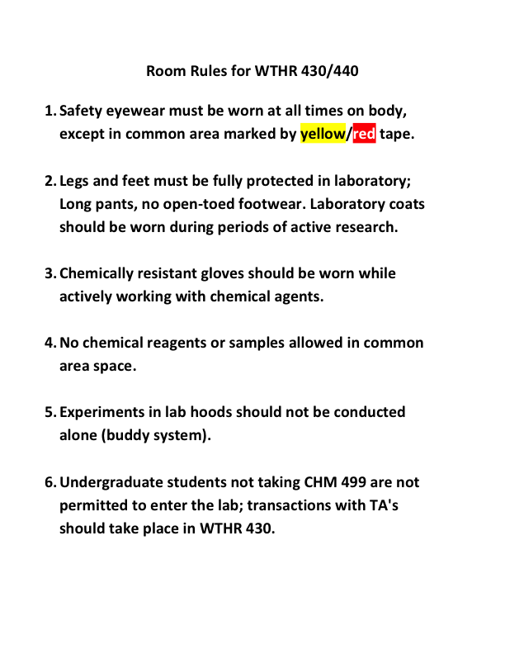
Room Rules
Example 2

Slide 6
Hazard Assessment
"Hazard assessment" is the process (required by law) of identifying the hazards associated with defined task, prescribing personal protective equipment and other relevant protection measures which must be employed to reduce the risk from the hazards. "Certification of Hazard Assessment" is a written document detailing the hazard assessment(s) for (a) particular task(s). The supervisor is responsible for ensuring that hazard assessments are performed and the certification(s) written and posted.
It must be modified to meet the specific hazards of your work area.

Slide 7
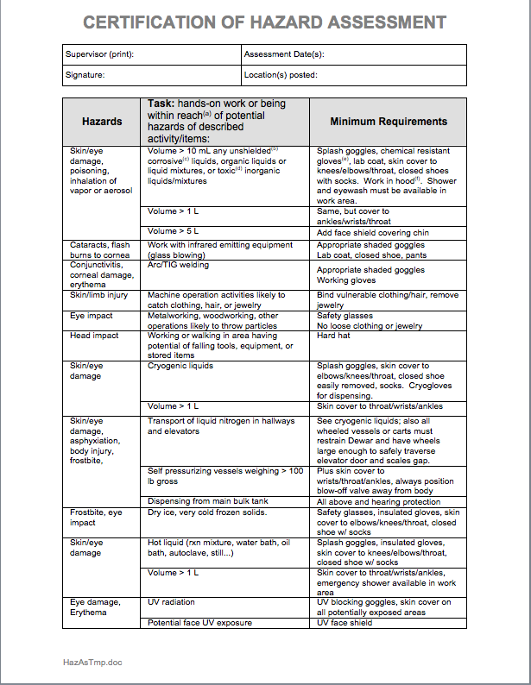
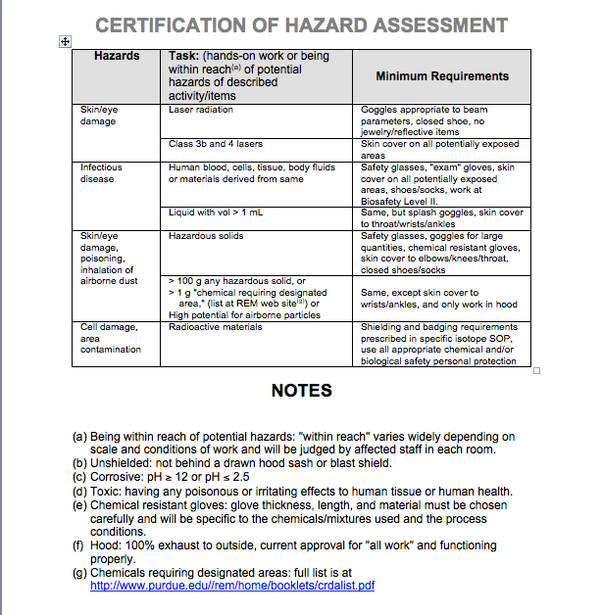
The complete Hazard Assessment form. Remove items from this that are not required.

Slide 8
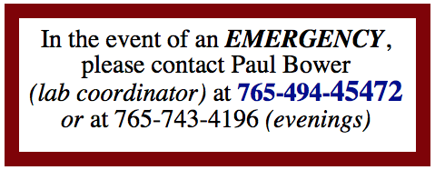
24 Hour Emergency Contact Sign
Must be posted on Outside of Door leading to labs.
With Cell Phones, you should also include the area code on phone numbers.

Slide 9
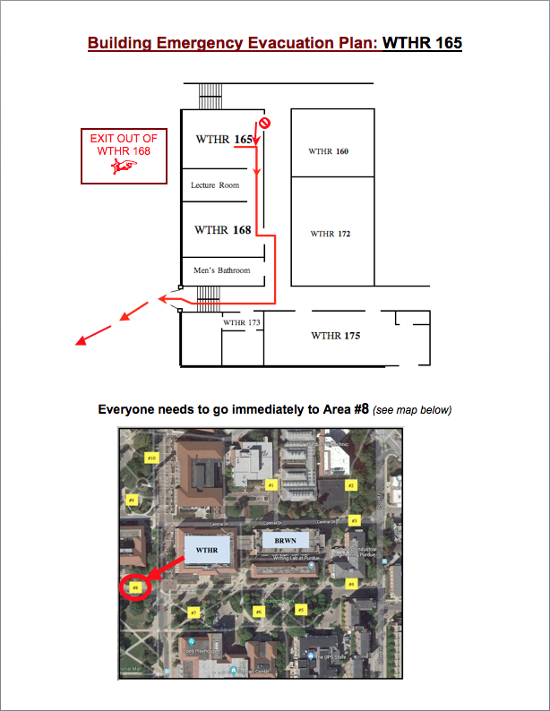
Emergency Assembly Areas (EAA)
Must be posted on Inside of Door leading to hallways.
Show a map of building in your area.
Show the path that students should take, and where they should go to.

Slide 10

Non-Exit Doors
Must be posted on any door that leads to a dead-end.
Its purpose is to let people know, in an emergency, that this door does not allow you to get to a hallway to exit the building.

